Slide 1




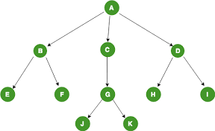
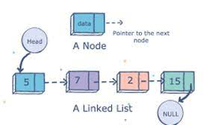
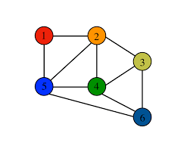
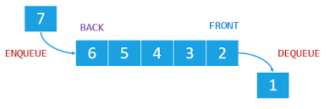
18EC670- DATA STRUCTURES AND ALGORITHMS LAB MINI PROJECT BATCH : 2020-2024 ACADEMIC YEAR: 2022-23
Team leader : Pa. Yazhini Malar
Team mates :
Kausik Rajan
Dharshan
Aswin kalies
Thowfiq
Bala Murugan-15
Karmugil
Madhan Kumar
Michael Reethi
Rajeshwari
Praveen kumar
ViswaVishal
Neha
Venkatesh
Kamalesh
Kausika
BetTina Helen
Priya Dharshini
Serina
Viswa
Raghul
Parameshwar
Kumaraganesh
Manisha
Bavithra
Aahash
SHakthi shree
Abijith
Rithick
Deepthika
Aardarsh
Lalith Kishore
Aravind raj
Pooja

Slide 2
MINI PROJECT – TEAM 2
CYBER MAVERICKS
Objective :
To create a web application to prepare a hall plan with the provided facilities.

Slide 3
To feed the exam time table .
To get input data as the total number of students appearing for the exam with respect to the course code .
To find the number of Halls required for the exam (Input can be the number of rows and columns in a Hall No., Default is 7 rows and 5 columns but adjustable row/column size is preferred.
To find the seating arrangement of students in a Hall in such a way maximum distance is maintained between the students appearing for same exam .
To save the Hall plans as pdf format .

Slide 4
Process flow :
Click on to the link to prepare the hall chart
yes
Displays the no. of halls needed for the total no. of students
Add entry
no
Enter the needed input details
Click Generate halls
Click generate seating arrangements
Displays a table with the given details
Enter no. of rows and columns
Shows the seating arrangements for the given data

Slide 5
Justification :
ADT – Array – QUEUE – Linear ADT
We have used the implementation of the course scheduling problem using a greedy algorithm. The algorithm assigns students to courses and arranges them into halls. The goal is to minimize the number of halls needed to accommodate all students while ensuring that no two students taking the same course are placed in the same table.

Slide 6
The algorithm starts by creating an unfilled hall and iterating through each column and row to assign students to courses.
It removes any filled courses, selects the next course using a round-robin approach, and places students in the hall if there are no other students taking the same course in the same row or column.
The algorithm also assigns a unique registration number to each student based on their course and the order in which they are placed in the hall. The registration numbers are stored in a list for each course.
The algorithm continues to create new halls and assign students until all students are accommodated. Finally, it prints out the number of halls needed to accommodate all students.

Slide 7
In terms of data structures, the code uses lists to store the courses, the number of students taking each course, and the starting registration number for each course. It also uses a list of lists to represent the halls, with each inner list representing a row in the hall. Additionally, the code uses a list of lists to store the registration numbers for each course.
An Abstract Data Type (ADT) used in this code is a Queue.
A Queue is a data structure that allows elements to be added at the end and removed from the front, following the First-In-First-Out (FIFO) principle. In the context of this code, a queue is used to store the courses that have not been allocated to any seat in the hall.
Whenever a seat is allocated to a course, that course is removed from the front of the queue. If a course cannot be allocated to any seat in the current hall, it can be added to the back of the queue. This process continues until all the courses have been allocated to seats in the hall.
Using a queue makes the code more efficient, as it can eliminate the need to iterate over the entire list of courses repeatedly to find the next course to allocate. Instead, the next course can be obtained by removing it from the front of the queue, which is a constant time operation.

Slide 8

LOGO & Tag line :
PlanMate
Never miss an exam again with Plan mate – Your ultimate hall plan preparation site

Slide 9

Homepage:

Slide 10
SOURCE CODE
GitHub Repo: https://github.com/YazhiniMalar/PlanMate

Slide 11
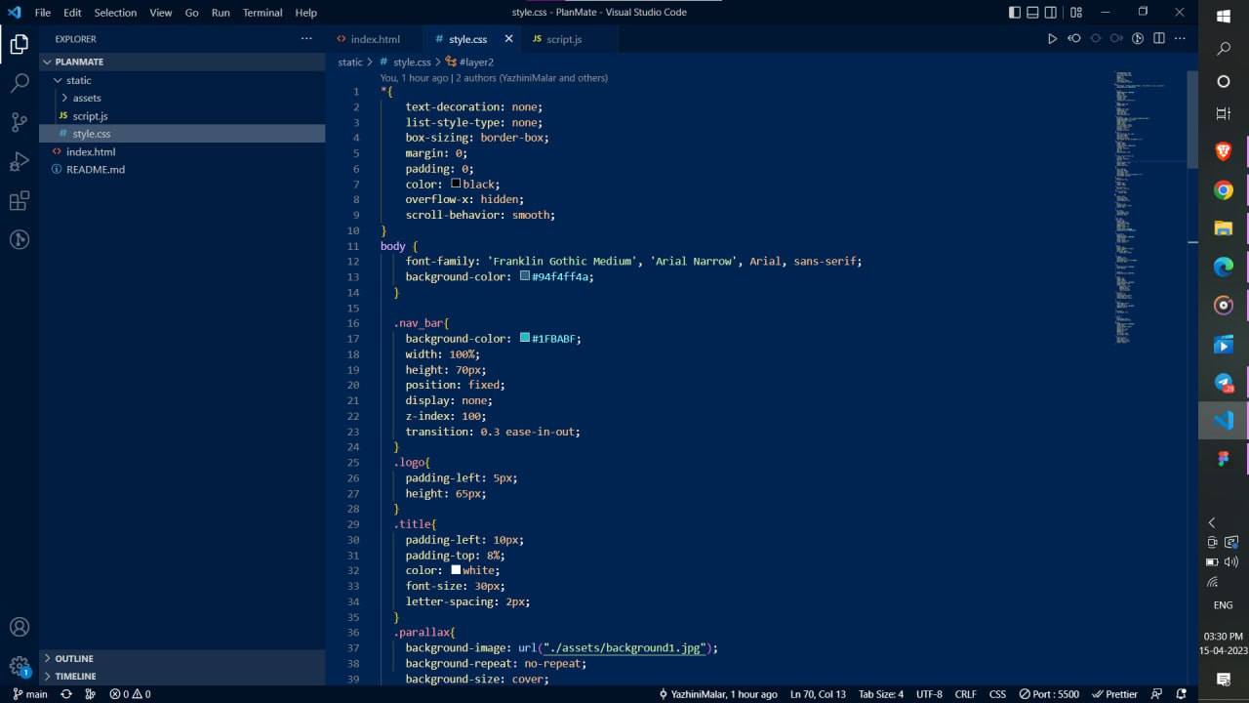
Webpage creation :

Slide 13
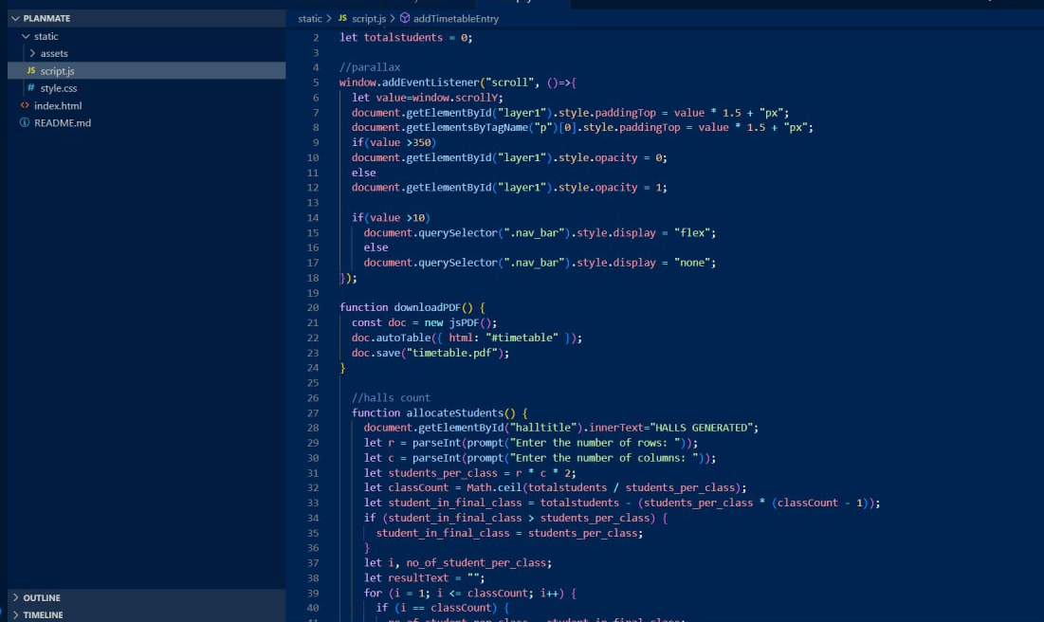

Slide 14
Hall requirement :
#include <stdio.h>
int main()
{
int r, c, total_students, students_per_class, class;
printf("Enter the number of rows: ");
scanf("%d", &r);
printf("Enter the number of columns: ");
scanf("%d", &c);
printf("Enter the total number of students: ");
scanf("%d", &total_students);
students_per_class= r * c ;
class = total_students / students_per_class;
if (total_students % students_per_class != 0) {
class++;
}

Slide 15
int student_in_final_class = total_students - (students_per_class * (class - 1));
if (student_in_final_class > students_per_class)
{
student_in_final_class = students_per_class;
}
int i, no_of_student_per_class;
for (i = 1; i <= class; i++) {
if (i == class) {
no_of_student_per_class = student_in_final_class; }
else {
no_of_student_per_class = students_per_class; }
printf("Class %d: %d students\n", i, no_of_student_per_class); }
return 0;
}

Slide 16
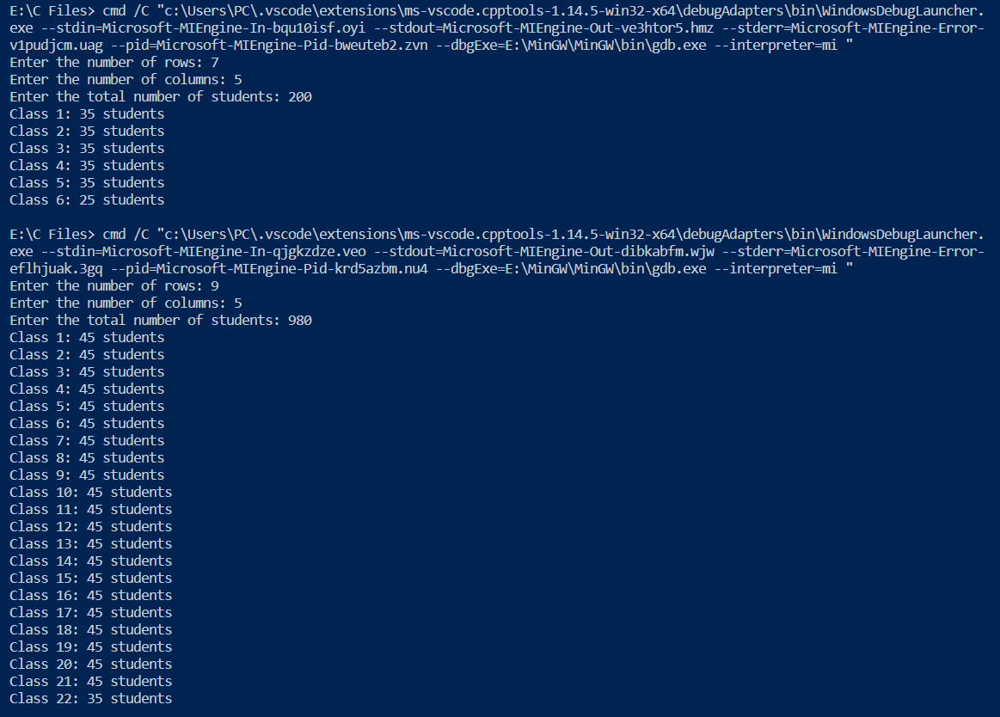
Output :

Slide 17
Time complexity :
The time complexity of this code is O(1) – constant time complexity.
The reason is that the code performs a fixed number of operations, regardless of the input size. The input size only affects the number of times the code runs through the loop.
The maximum no. of iterations is fixed as it depends on the division of the total number of students by the product of rows, columns, and 2, which is done only once.

Slide 18
Seating arrangements :
# Collecting Values
r_r=int(input(""))
r_c=int(input(""))
cor=list(map(str,input("").strip().split()))
cc=list(map(int,input("").strip().split()))
reg_no=list(map(str,input("").strip().split()))
print()
# Initialization of index and count of hall
reg_no_cc=[];
reg_index=0;
for i in range(0,len(cc)):
reg_no_cc.append(reg_no[i].split("D"));
index=0
c=0
while(True):
# Create unfilled Hall
a=[]
b=[]

Slide 19
for i in range(r_r+2):
a.append(["X" for j in range(r_c+2)])
for i in range(r_r+2):
b.append(["XXXXXXXXXXXXXX" for j in range(r_c+2)])
# Hall arrangment starts
for j in range(1,r_c+1):
for i in range(1,r_r+1):
if(sum(cc)==0):break #While all the students are settle down break the loop
# Remove the filled courses
while(True):
try:
index1=cc.index(0)
cc.remove(cc[index1%len(cc)])
cor.remove(cor[index1%len(cor)])
reg_no_cc.remove(reg_no_cc[index1%len(reg_no)])
except:
break

Slide 20
# Indexing index=index%len(cc) # Ex: If Course A have no of student > 0 and their is no student at the NEWS position then place a student studing #couese A if(a[i][j-1]!=cor[index] and a[i][j+1]!=cor[index] and a[i-1][j]!=cor[index] and a[i+1][j]!=cor[index]and cc[index]!=0): reg_index=index; t=cor[index]+'-'+reg_no_cc[reg_index][0]+"D"+reg_no_cc[reg_index][1] reg_no_cc[reg_index][1]=int( reg_no_cc[reg_index][1])+1 if int( reg_no_cc[reg_index][1])<10: reg_no_cc[reg_index][1]="00"+ str(reg_no_cc[reg_index][1]) elif int( reg_no_cc[reg_index][1])>9 and int( reg_no_cc[reg_index][1])<100: reg_no_cc[reg_index][1]="0"+str( reg_no_cc[reg_index][1])

Slide 21
else: reg_no_cc[reg_index][1]=str( reg_no_cc[reg_index][1]) a[i][j]=cor[index] b[i][j]=t cc[index]-=1 index+=1 # increase the Index if(sum(cc)==0):break #While all the students are settle down break the loop c+=1 # Incre ment the hall Count #print the hall arrangement for i in b[1:r_r+1]: for j in i[1:r_c+1]: print(j,end=" ") print() print() if(sum(cc)==0):break #While all the students are settle down break the loop print("Total Number of halls: ",c) #Print the No. of halls allocated

Slide 22
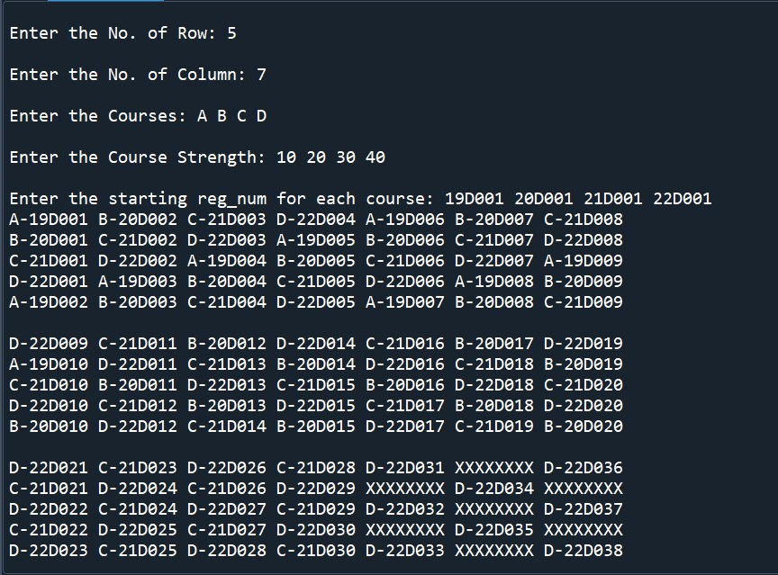
Outputs & Test case :

Slide 23
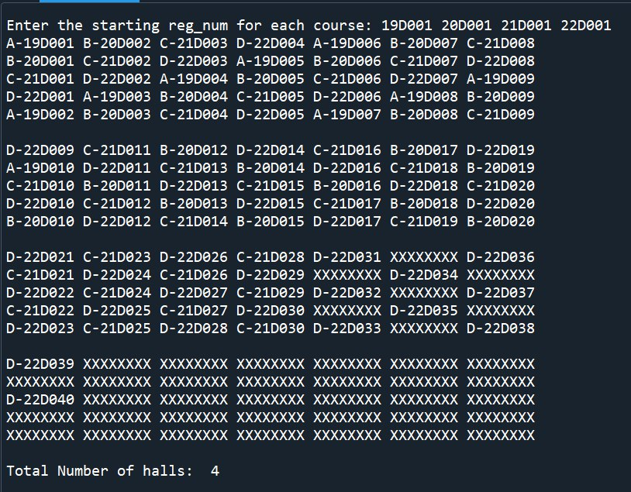

Slide 24
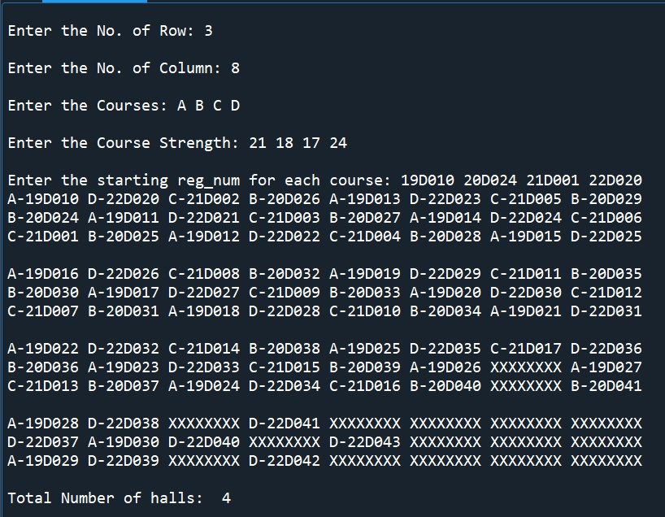

Slide 25
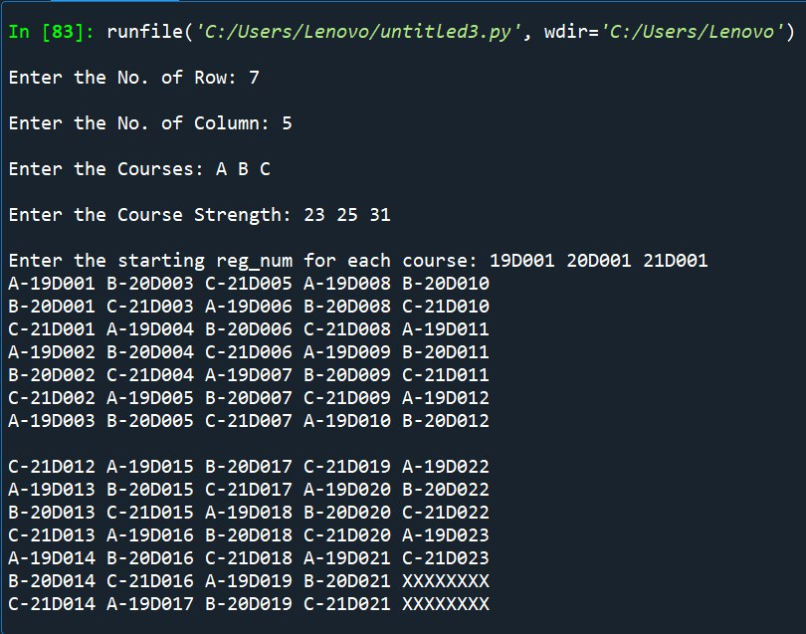

Slide 26
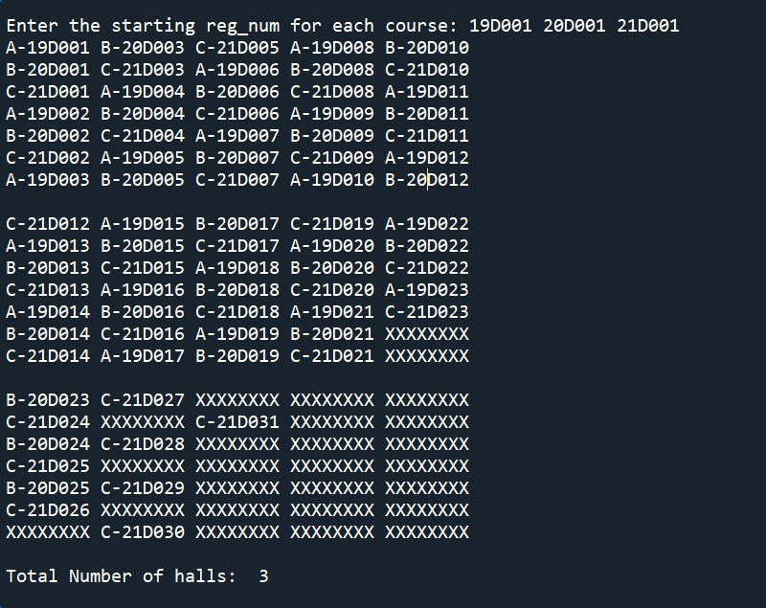

Slide 27
Use case :
It is helpful for the exam centers to streamline the seating arrangement process and ensure a smooth and efficient exam process.
It can also take into account factors such as the capacity of the exam hall, the number of examiners, and the number of students taking the exam.
This can ensure that the seating arrangements is optimal and efficient.
This can be helpful for the staff to assign seats to examiners based on factors like subject or other specific requirements.

Slide 28
Tasks Contributed :
Creation of LOGO
Name & Tagline
Webpage development
Hall requirement implementation
Seating arrangement implementation
Additional features
PPT & Document preparation

Slide 29


Demonstration :
CLICK ME TO FOLLOW TO MY WEBPAGE

Slide 30


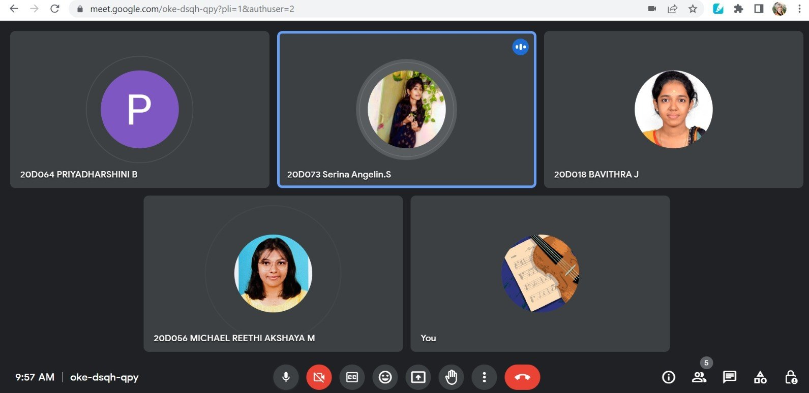
Sub team meets :

Slide 31


Slide 32
Problem faced/Constraints:
The developed seating arrangement code works well only when the number of rows are in odd count, When the number of rows are in even count the code doesn’t give an efficient output.
Number of courses should not be equal to number of number of rows.
If No. of students in one course is massively more when compared to others, extra halls will be needed.
Running python code in web applications without backend or virtual environment.

Slide 33
Conclusion :
We conclude that the development of exam hall chart generator tool can be useful for educational institutions and exam centers. This tool can streamline the process of creating the seating arrangements for the examiners, taking into account with factors like date, time, year of study, type of subject, the size of the exam hall. And number of students taking the exam.

Slide 34
Future scope :
The generator can create a visual representation of the exam hall and seating plan, which can help the staff to assign seats to examiners more efficiently and effectively. This can ensure a smooth and efficient exam process for all involved, and can reduce the risk of any disturbances or disruptions during the exam.

Slide 35
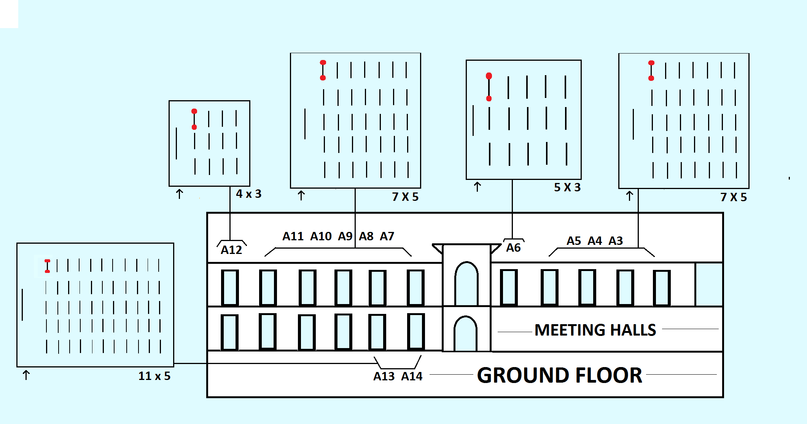

Slide 36
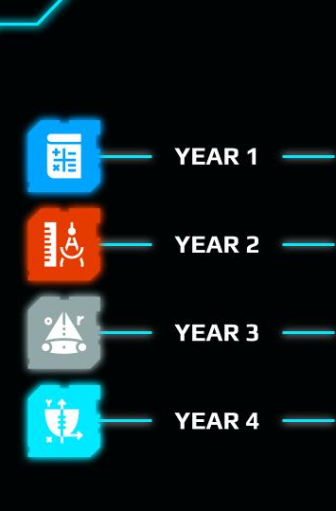
References :
https://docs.oracle.com/en/java/
https://developer.mozilla.org/en-US/docs/Web/CSS
https://developer.mozilla.org/en-US/docs/Web/HTML
https://chat.openai.com/

